Slide 1

BATCH NO: D28

Slide 2
ABSTRACT
Product recommendation systems have become an essential component of e-commerce platforms, aiming to provide users with personalized suggestions.
Our system, built using simple Python packages and methods, recommends similar and related products to users based on their purchase history.
This project demonstrates the effectiveness of our approach and provides a new perspective on product recommendation systems.

Slide 3
KEY POINTS:
A product recommendation system predicts and shows items that a user would like to purchase.
Existing projects: Rely on a range of high end established recommendation techniques.
This project: Introduces a fresh approach with novel techniques, using basic Python tools.

Slide 4
ALGORITHMS USED:
1. Apriori Algorithm:
Mining the Treasure of Frequent Patterns
Key Feature: Identifies frequent item sets by exploring product combinations that frequently occur together.
2. Clustering Algorithms:
Grouping Similar Items for Enhanced Insights
Key Feature: Categorizes products into meaningful groups, making it easier to suggest items that match users' preferences.

Slide 5
Existing Projects:
Amazon's recommendation engine uses collaborative filtering, content-based filtering, and hybrid recommendation systems.
Google's recommendation engine uses machine learning algorithms and natural language processing.
Flipkart's recommendation engine uses a combination of collaborative filtering and content-based filtering.

Slide 6
Proposed Methodology::
AD
Data collection: Collect user purchase history data.
Data preprocessing: Preprocess the data using techniques such as tokenization and normalization.
Apriori algorithm: Apply the Apriori algorithm to generate frequent itemsets.
Clustering method: Apply clustering method to group similar products together.
Recommendation generation: Generate recommendations based on the clustered products.

Slide 7
OBJECTIVES:
Product Recommendation System Using Apriori Algorithm and Clustering
Identify Frequently Bought Together Products
Discover product relationships using Apriori for association rule mining.
Customer Segmentation
Use clustering to group customers with similar buying behavior for targeted recommendations.
Increase Cross-Selling
Suggest complementary products to increase order value.
Low Complexity Implementation
Simple algorithms suitable for small datasets without needing complex systems.
Personalized Recommendations
Provide recommendations based on past purchase patterns using customer clusters.

Slide 8
SOFTWARE REQUIREMENTS:
Platform: Windows 7/10/11
Programming Language: Python
Data Processing Libraries: Pandas
Machine Learning Libraries: Apyori (for association rule mining)
Graphical User Interface (GUI): Flask (for web-based interface)

Slide 9
HARDWARE REQUIREMENT:
Processor - Core i3/i5/i7
RAM - 2 GB/4GB
SSD – 256 GB

Slide 10
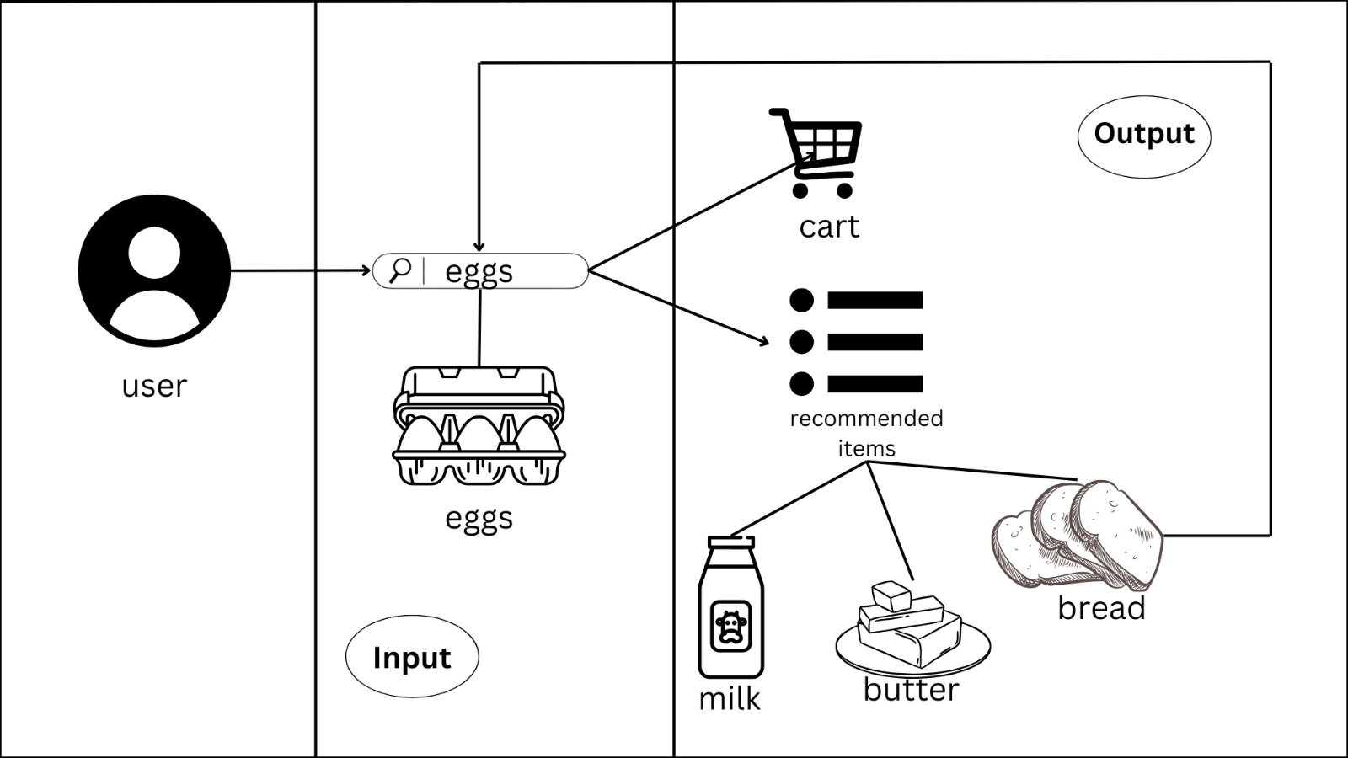
USER INTERACTION DIAGRAM
THANK YOU!

Slide 11
ARCHITECTURE DIAGRAM

Slide 12
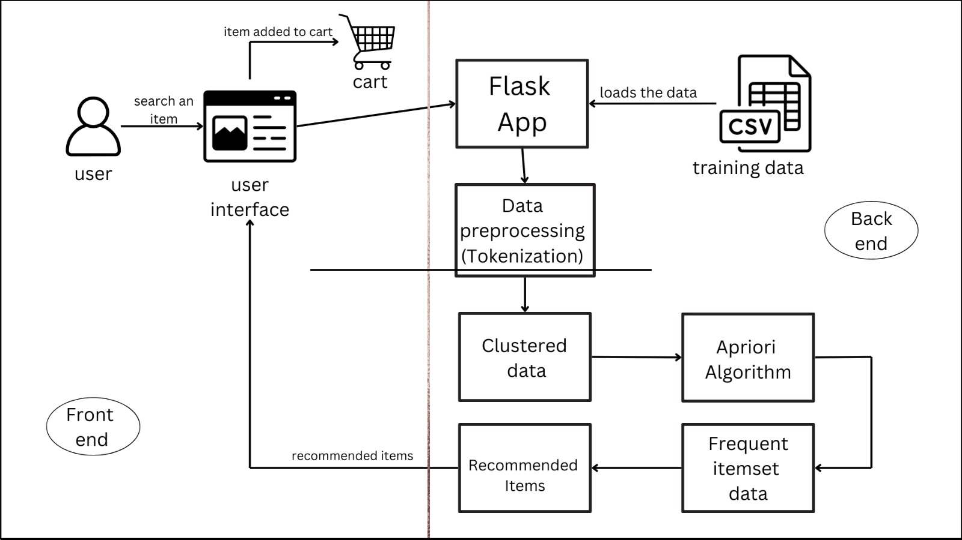

Slide 13
WORK FLOW:
User Purchase
History Data
Data Collection
Data Preprocessig
(Tokenization)
Preprocessed Data
Apriori Algorithm
Clustering Method
Clustered Products
Frequent Itemsets
Recommendation Generation
Personalized
Recommendations

Slide 14
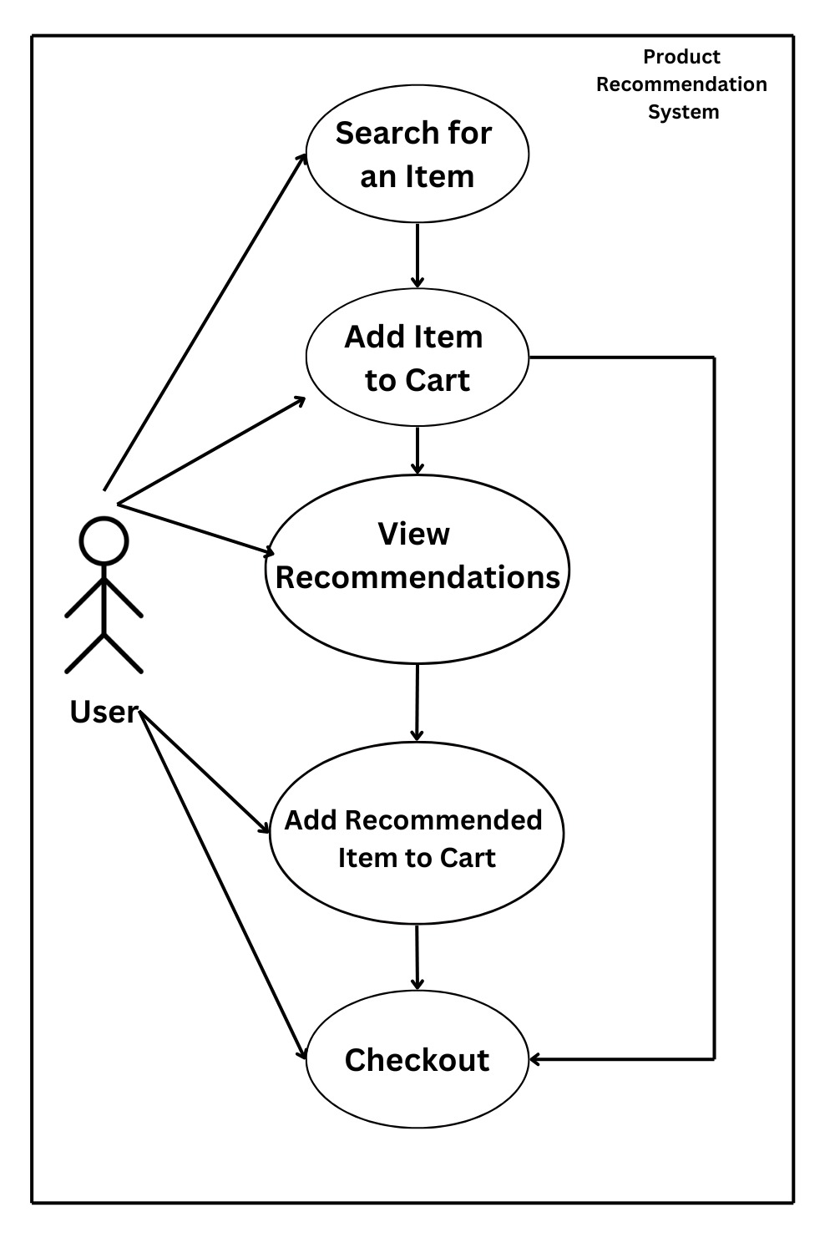
USE CASEDIAGRAM

Slide 15
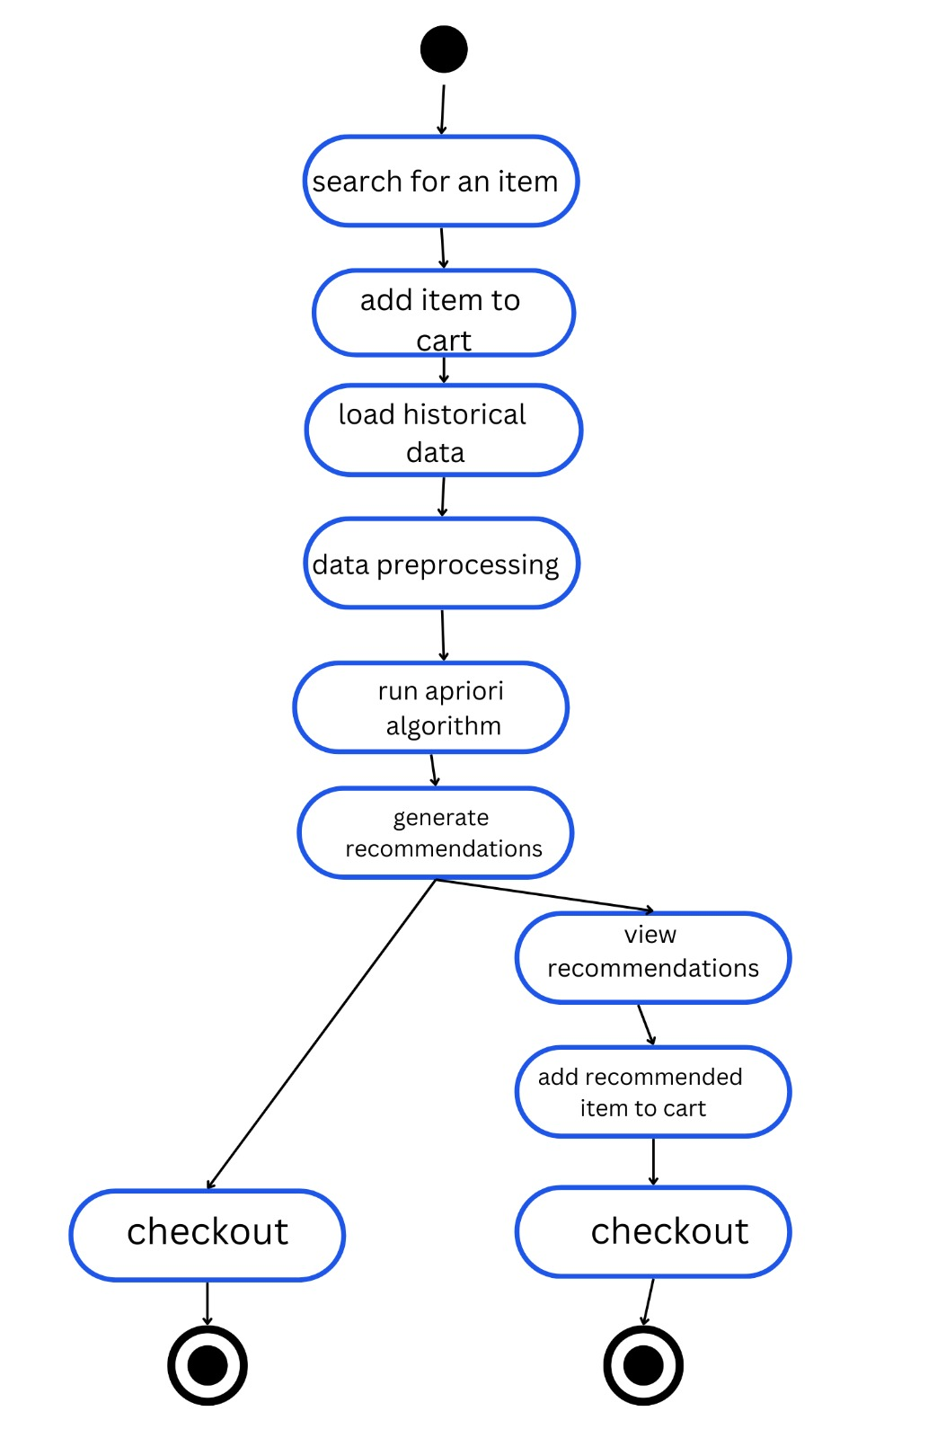
THANK YOU!
ACTIVITY DIAGRAM

Slide 16
BENEFITS:
IMPROVED USER EXPERIENE
INCREASED SALES FOR BUSSINESS
PERSONALISED SHOPPING

Slide 17
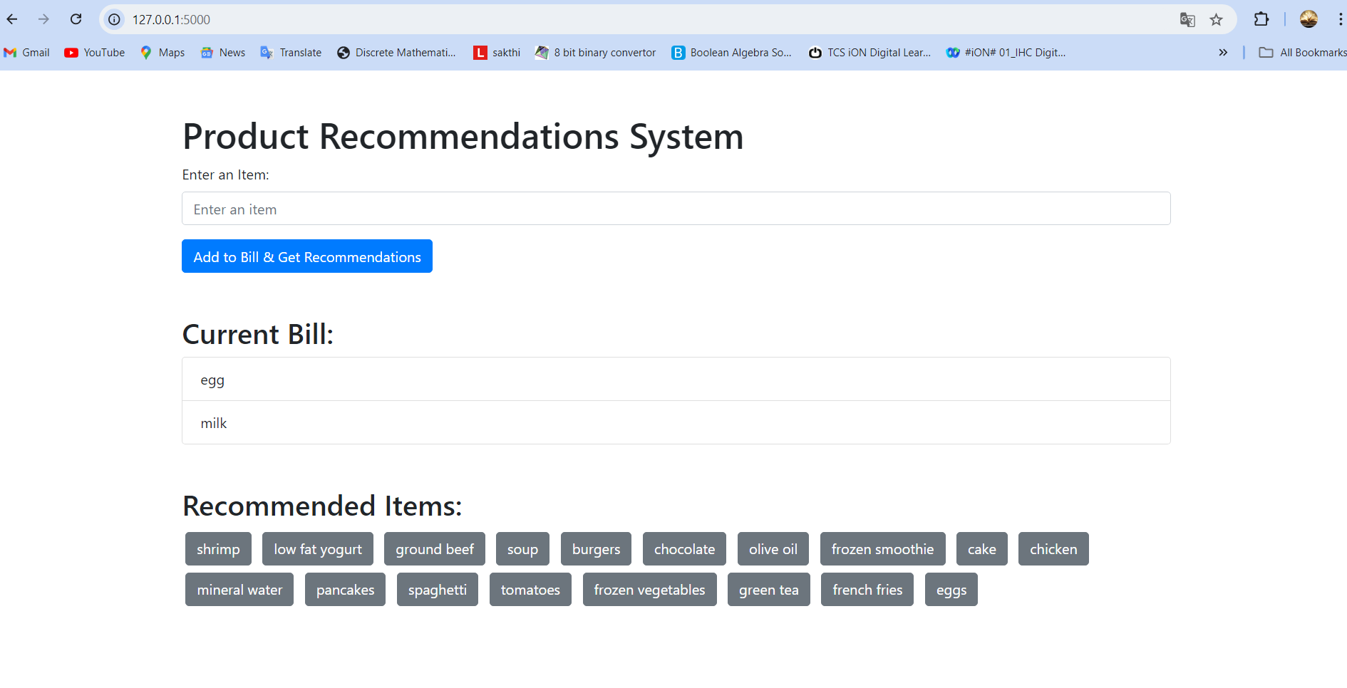
SAMPLE OUTPUT:

Slide 18
REFERENCES:
Recommendation Systems:
Fayyaz, Z., Ebrahimian, M., Nawara, D., Ibrahim, A., & Kashef, R. (2020). "Recommendation Systems: Algorithms, Challenges, Metrics, and Business Opportunities." Applied Sciences, 10(21), 7748.
Apriori Algorithm:
Phani Tarun Munukuntla, Shruti Mishra (2022). "Grocery Recommendation using Improvised Apriori Algorithm." IEEE Xplore.
Combining Apriori and Clustering:
Nasiri, E., & Rastegari, H. (2022). "A Hybrid Recommender System based on Clustering and Association Rules." Journal of King Saud University - Computer and Information Sciences.
Improved Apriori Algorithm:
Wang, J., & Jiang, M. (2022). "Research on Product Recommendation Based on Association Rules and Improved Apriori Algorithm." Academic Journal of Computing & Information Science, 5(3), 101-106. Francis Academic Press.

Slide 19
THANK YOU!

